Slide 1
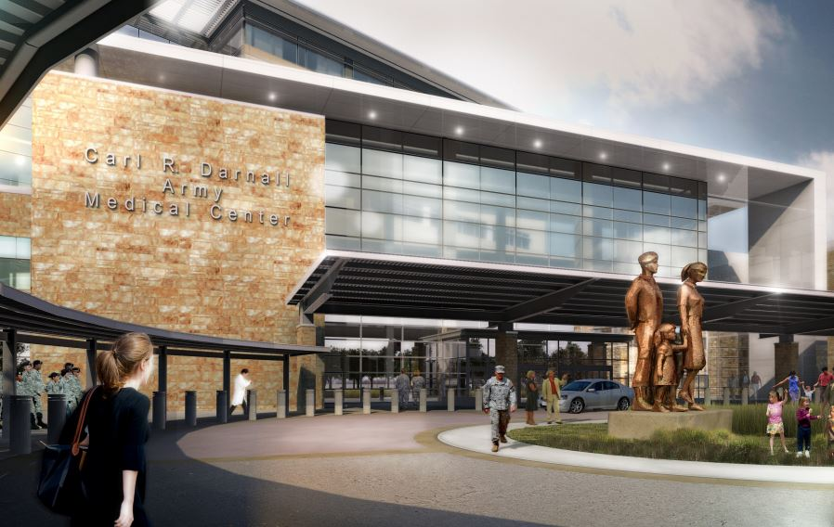
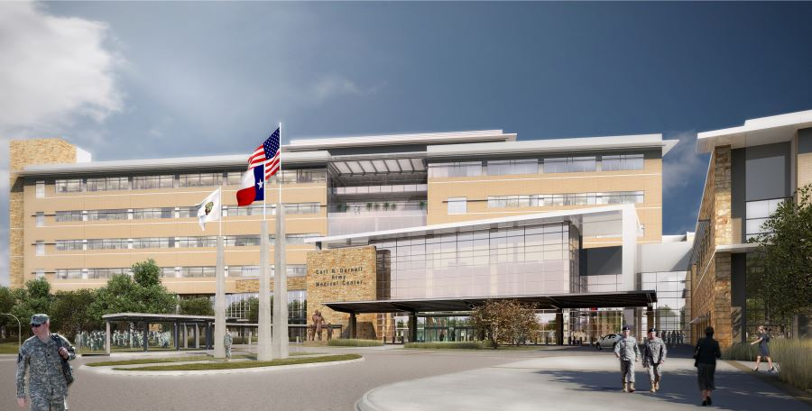
Carl R. Darnall Army Medical Center
Marissa Caldwell
Mechanical Option

Slide 2
Carl R. Darnall Army Medical Center
Building overview
Thesis Goals
Depth
Dedicated Outdoor Air System
Variable Refrigerant Flow
Water Source Heat Pump
Air Quality Analysis
Energy Comparison
Structural Breadth
Construction Breadth
Conclusion

Slide 3
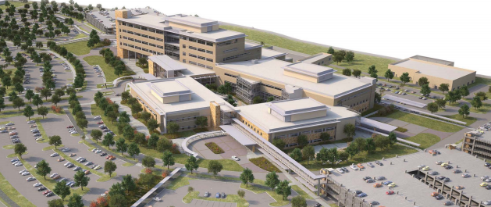
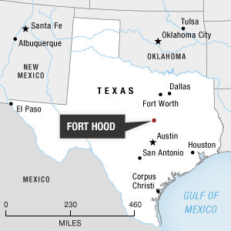
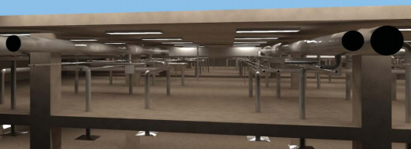
Building Overview
Building overview
Thesis Goals
Depth
Dedicated Outdoor Air System
Variable Refrigerant Flow
Water Source Heat Pump
Air Quality Analysis
Energy Comparison
Structural Breadth
Construction Breadth
Conclusion
Owner: Army Corps of Engineers
Department of Defense – UFC Standard 4-510
Located on Fort Hood Base, outside of Killeen, TX
Floor Area: 900,000 sq ft
Replacing the current Carl R. Darnall Army Medical Center across street
Notes:
Army Corps of Engineers is the owner of the building, so strict design criteria was used by implementing UFC 4-510 which is the unified facilities criteria whole building design guide. In between each floor of medical spaces and offices are interstitial floors. These interstitial floors, like the rendering on the right, house the communication, medical gas, Pneumatic tube, electrical and mechanical systems. Designed strictly for a facilities maintenance employee and a cart, the IBS floors are designed for low dead and live loads. Since the CAVs are located in this space, monthly maintenance is easy to do.

Slide 4
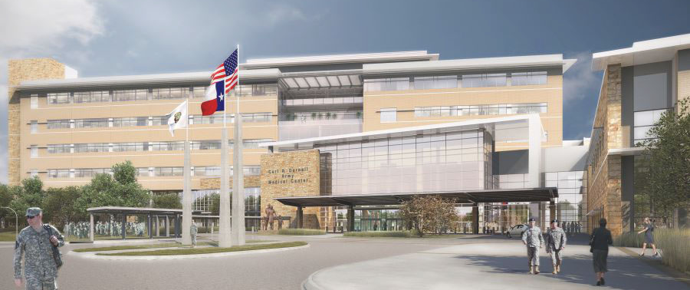
Building Overview
Building overview
Thesis Goals
Depth
Dedicated Outdoor Air System
Variable Refrigerant Flow
Water Source Heat Pump
Air Quality Analysis
Energy Comparison
Structural Breadth
Construction Breadth
Conclusion
Patient Rooms
Level 5
Medical Support
Conference
Offices
Level 6
Library
Notes:
Since this building is massive, the top two floors of the bed tower were analyzed for
Red are patient rooms, purple is medical support space
Green are offices, purple are conference rooms, red/orange is a library

Slide 5
Building Overview
Building overview
Thesis Goals
Depth
Dedicated Outdoor Air System
Variable Refrigerant Flow
Water Source Heat Pump
Air Quality Analysis
Energy Comparison
Structural Breadth
Construction Breadth
Conclusion
Level 5
Level 6
Notes:
Since this building is massive, the top two floors of the bed tower were analyzed for
Red are patient rooms, purple is medical support space
Green are offices, purple are conference rooms, red/orange is a library

Slide 6
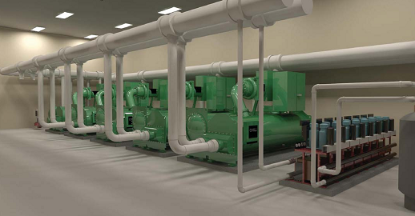
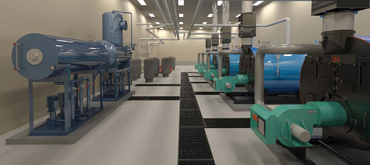
Mechanical System
Building overview
Thesis Goals
Depth
Dedicated Outdoor Air System
Variable Refrigerant Flow
Water Source Heat Pump
Air Quality Analysis
Energy Comparison
Structural Breadth
Construction Breadth
Conclusion
Cooling System
Heating System
(4) 1,300 ton centrifugal chillers
(4) 18,000 MBH cooling towers
200 ton heat recovery chiller
Domestic hot water & chilled water
Provides 44°F to AHUs
(4) 11,700 MBH steam boilers
Low Nox burner & boiler stack economizer
(3) Steam to water heat exchanger
Steam for humidification & sterile equipment
Provides 140°F to AHUs and CAVs
Notes:
As previously mentioned, the central utility plant is located off site, just feet from the hospital. All services provided are transported via the utility tunnel connecting the CUP to the main building. The mechanical system comprises of a steam system and a chilled water system. The Cooling system comprises of 4 1,300 centrifugal chillers, 4 18,000 MBH cooling towers and 1 200 ton heat recovery chiller. The heat recovery chiller provides pre heating for the domestic hot water and provides a chilled water base load. For the heating system, there are four 11700 MBH steam boilers and 3 steam to water shell and tube heat exchangers provides 140F hot water to CAVs and AHUs. Steam boiler along with the boiler stack economizer allow for the 85% efficiency. Steam is provided for humidification & sterile equipment, as well as kitchen equipment.

Slide 7
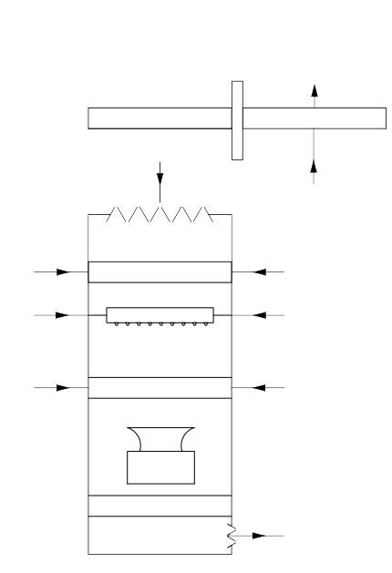
Mechanical System
Building overview
Thesis Goals
Depth
Dedicated Outdoor Air System
Variable Refrigerant Flow
Water Source Heat Pump
Air Quality Analysis
Energy Comparison
Structural Breadth
Construction Breadth
Conclusion
Airside System
General Exhaust
General Exhaust
WHEEL
HWS 140°F
SHU
CHWS 44°F
SUPPLY AIR
PRE-CONDITIONED OUTDOOR
AIR
HEATING COIL
COOLING COIL
ENTHALPY
HUMIDIFIER
FAN
FILTER
Enthalpy wheel to precondition outdoor air
(2) 45,000 cfm air handler providing 55°F air
Constant Air Volume terminal units with reheat
HWR 110°F
SHUC
CHWR 60°F
Notes:
Each floor is provided conditioned 55F outdoor air by a dedicated outdoor air system in the penthouse. The dedicated outdoor air handlers provide preconditioned air at 55F to the constant air volume terminal units located in the interstitial space. The CAVs are arranged one per patient room and they supply 100% outdoor air to condition the space.

Slide 8
Building overview
Thesis Goals
Depth
Dedicated Outdoor Air System
Variable Refrigerant Flow
Water Source Heat Pump
Air Quality Analysis
Energy Comparison
Structural Breadth
Construction Breadth
Conclusion
Reduce Energy
Economically Feasible
Safe Community
Structurally Stable

Slide 9
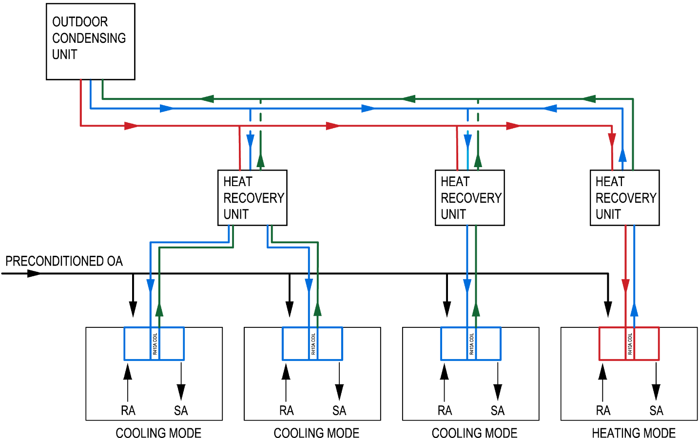
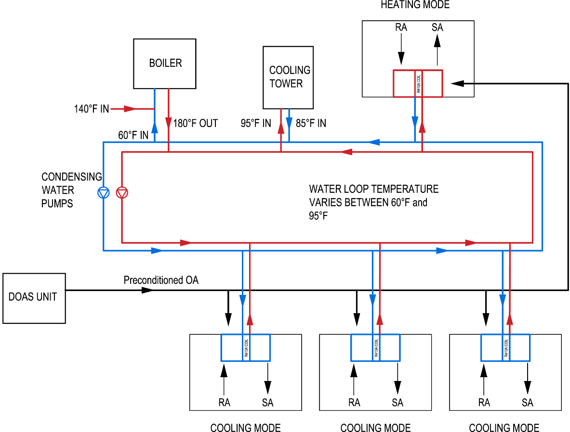
Variable Refrigerant Flow
Water Source Heat Pump
Building overview
Thesis Goals
Depth
Dedicated Outdoor Air System
Variable Refrigerant Flow
Water Source Heat Pump
Air Quality Analysis
Energy Comparison
Structural Breadth
Construction Breadth
Conclusion
Low Pressure Line
Vapor Suction Line
High Pressure Line
Notes:
Variable Refrigerant Flow & Water Source Heat Pump
Simultaneous heating & cooling
Eliminates the chiller
Separate zone controls
Uses heat rejected from each space

Slide 10
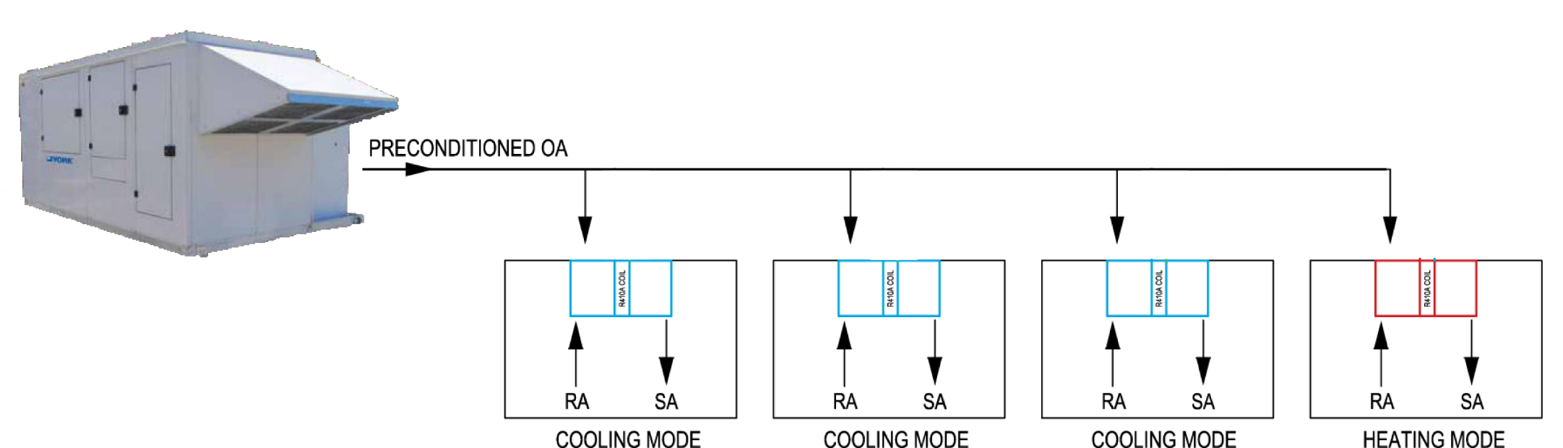
Dedicated Outdoor Air System
Building overview
Thesis Goals
Depth
Dedicated Outdoor Air System
Variable Refrigerant Flow
Water Source Heat Pump
Air Quality Analysis
Energy Comparison
Structural Breadth
Construction Breadth
Conclusion
DOAS Unit | Baseline Design | DOAS Unit | DX Cooling Coil | Natural Gas Coil
 | Supply OA (cfm) | OA Supply (cfm) | Total Capacity (MBH) | Total Capacity (MBH)
L5 AHU | 26,090 | 7,380 | 360 | 80
L6 AHU | 37,075 | 10,366 | 300 | 60
DOAS delivers air directly to the space in VRF system
Enthalpy wheel with general exhaust
WSHP reduces by 32%, VRF reduces by 60%

Slide 11
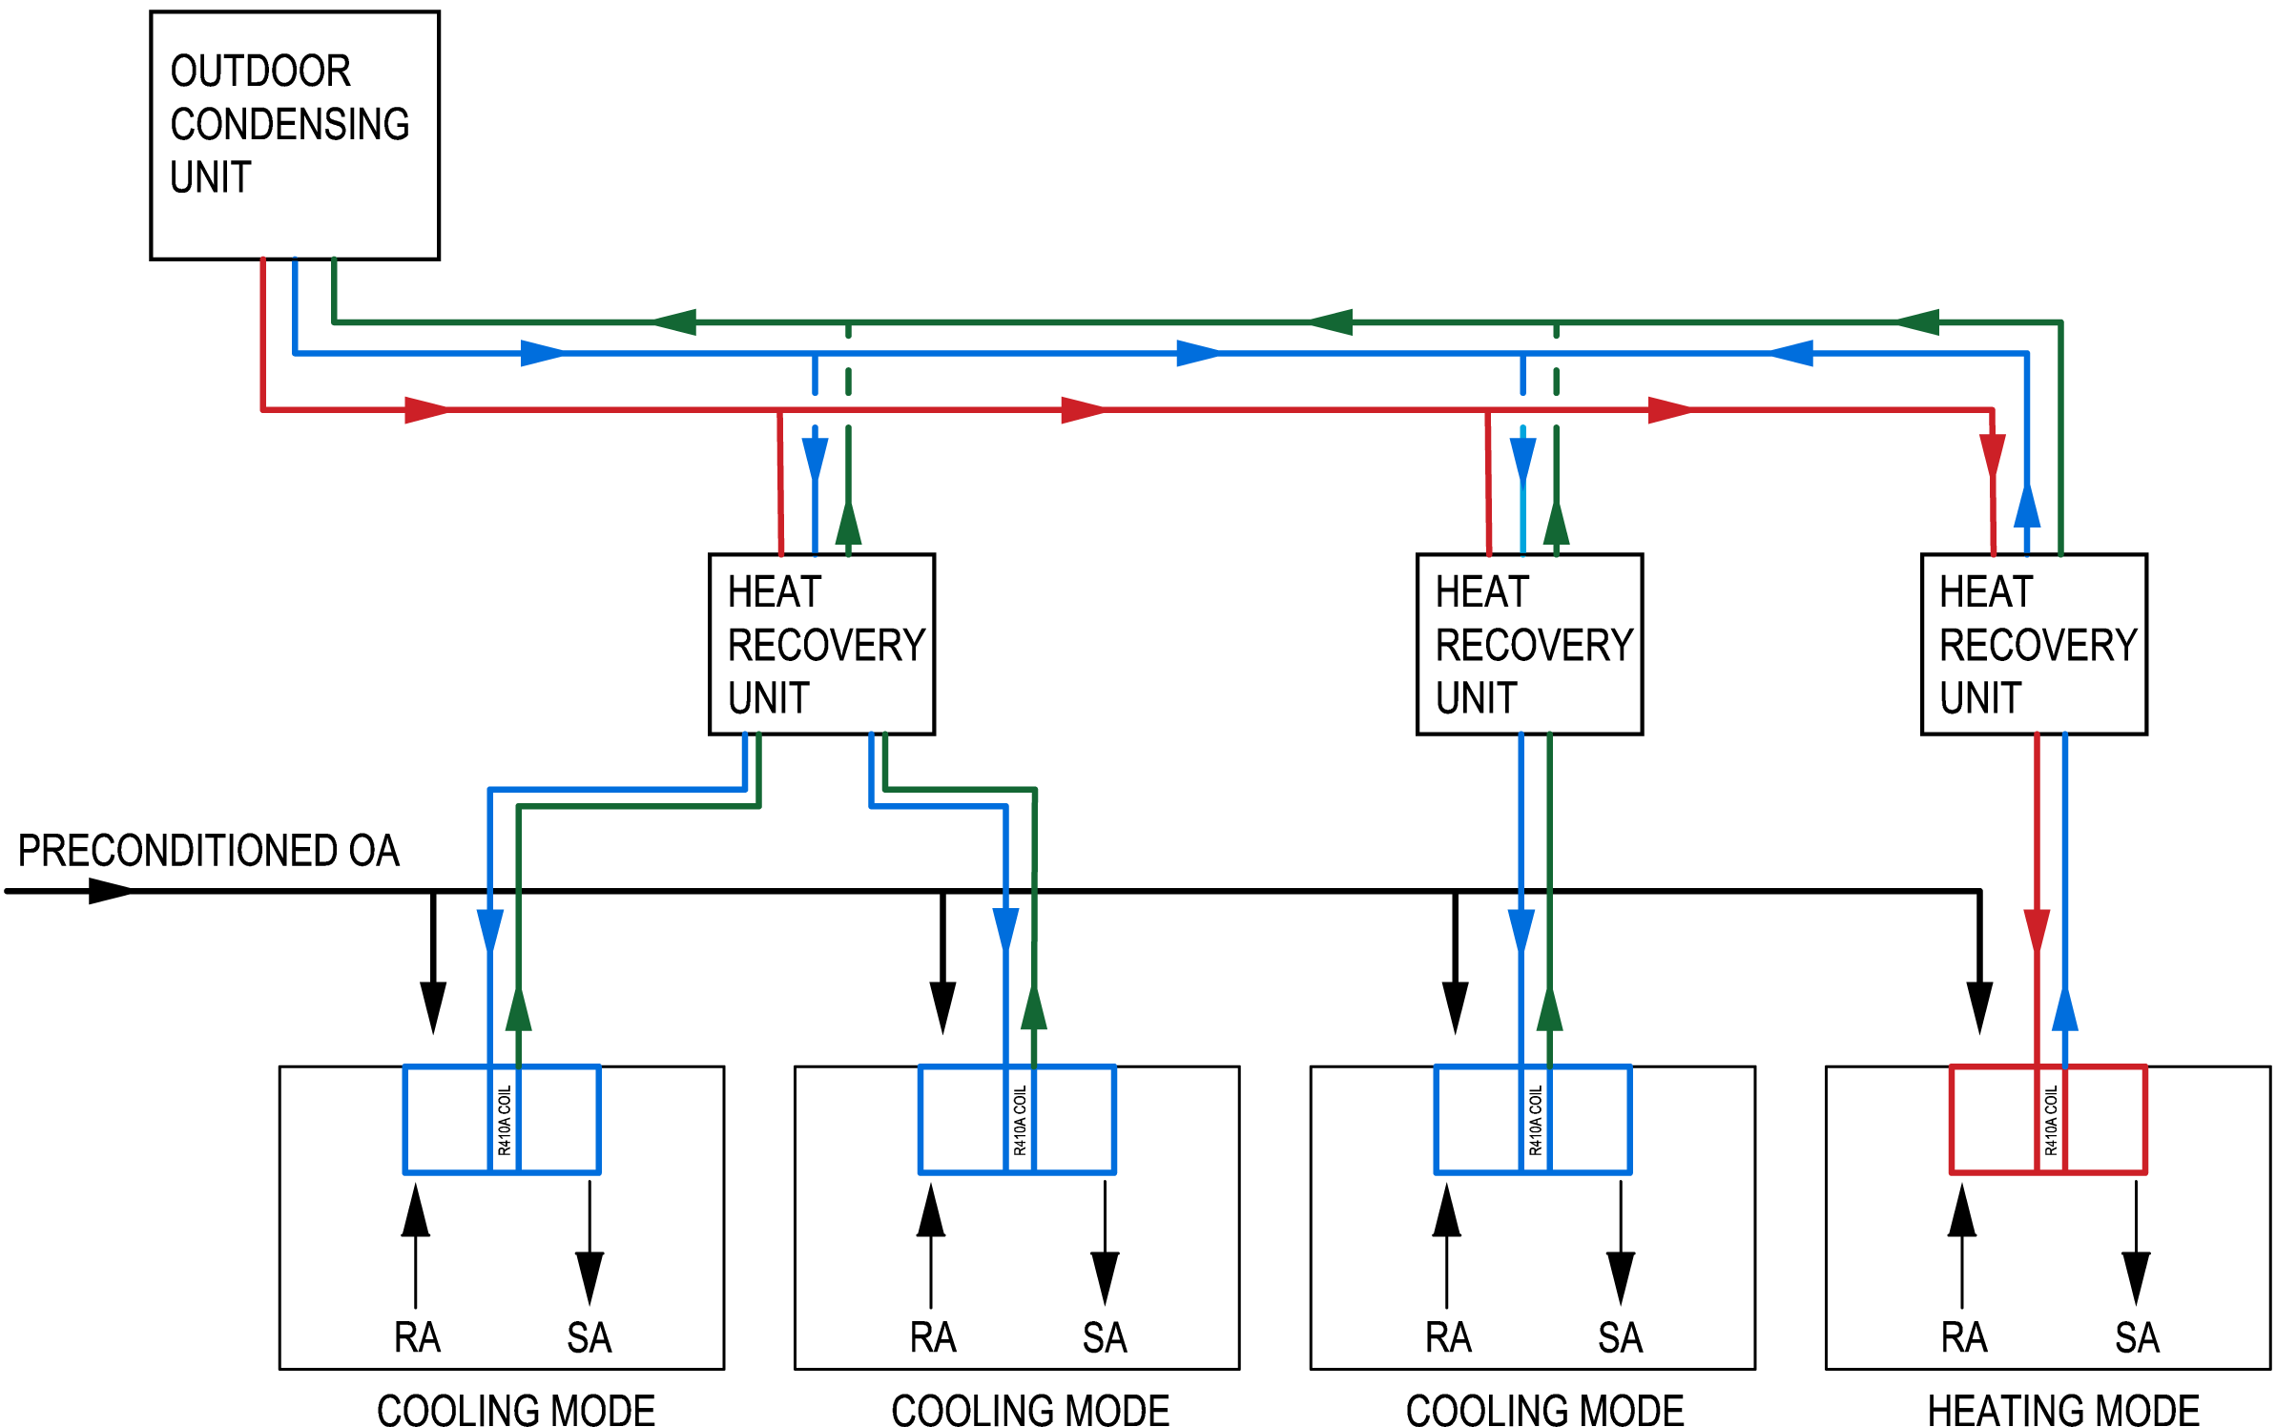
Variable Refrigerant Flow
Building overview
Thesis Goals
Depth
Dedicated Outdoor Air System
Variable Refrigerant Flow
Water Source Heat Pump
Air Quality Analysis
Energy Comparison
Structural Breadth
Construction Breadth
Conclusion
Low Pressure Line
Variable Refrigerant Flow With R-410A
Indoor VRF units have the ability to operate as a condenser and a evaporator
Consists of 3 pipes: low pressure, high pressure & vapor suction line
Heat recovery Vs. heat pump
Defrost Operation
Vapor Suction Line
High Pressure Line

Slide 12
ASHRAE 15 Compliance
Building overview
Thesis Goals
Depth
Dedicated Outdoor Air System
Variable Refrigerant Flow
Water Source Heat Pump
Air Quality Analysis
Energy Comparison
Structural Breadth
Construction Breadth
Conclusion
ASHRAE 15 Refrigerant Charge Limit
 | OEL (ppm/v/v) | Safety Group | RCL |  |  | Highly Toxic or Toxic Under Code Classification
 |  |  | ppm v/v | lb/Mcf | g/m^3
R-410A | 1,000 | A1 | 140,000 | 13 | 420 | Neither
Level 5
Refrigerant Charge Calculations
Zone Configuration | Zone | Outdoor Unit |  | Capacity (tons) | # Indoor Units | RCL (lb/Mcf) | Comply with ASHRAE 15?
 |  | Cooling | Heating
Zoning 1 | L5 South Exterior | 264,000 | 297,000 | 22 | 23 | 22.14 | NO
Zoning 2 | L5 South East Ext | 144,000 | 162,000 | 12 | 12 | 19.50 | NO
 | L5 South West Ext | 120,000 | 135,000 | 10 | 11 | 19.76 | NO
Zoning 3 | L5 South West Ext | 96,000 | 108,000 | 8 | 11 | 12.17 | YES
 | L5 S Exterior Zone | 96,000 | 108,000 | 8 | 10 | 12.15 | YES
 | L5 SE Exterior Zone | 96,000 | 108,000 | 8 | 10 | 11.82 | YES
 | L5 SE Corner Zone | 96,000 | 108,000 | 8 | 10 | 11.68 | YES
Level 6
Institutional Occupancy & Indirect Closed System
Concentration may not exceed 50% listed in table 4-1
Multi-V Refrigerant Charge Calculator
Small rooms use in-duct VRF indoor units

Slide 13
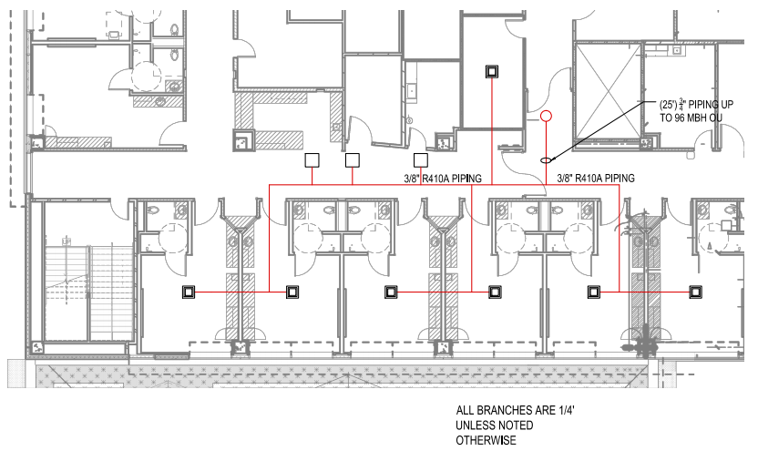
ASHRAE 15 Compliance
Building overview
Thesis Goals
Depth
Dedicated Outdoor Air System
Variable Refrigerant Flow
Water Source Heat Pump
Air Quality Analysis
Energy Comparison
Structural Breadth
Construction Breadth
Conclusion
ASHRAE 15 Refrigerant Charge Limit
 | OEL (ppm/v/v) | Safety Group | RCL |  |  | Highly Toxic or Toxic Under Code Classification
 |  |  | ppm v/v | lb/Mcf | g/m^3
R-410A | 1,000 | A1 | 140,000 | 13 | 420 | Neither
Refrigerant Charge Calculations
Zone Configuration | Zone | Outdoor Unit |  | Capacity (tons) | # Indoor Units | RCL (lb/Mcf) | Comply with ASHRAE 15?
 |  | Cooling | Heating
Zoning 1 | L5 South Exterior | 264,000 | 297,000 | 22 | 23 | 22.14 | NO
Zoning 2 | L5 South East Ext | 144,000 | 162,000 | 12 | 12 | 19.50 | NO
 | L5 South West Ext | 120,000 | 135,000 | 10 | 11 | 19.76 | NO
Zoning 3 | L5 South West Ext | 96,000 | 108,000 | 8 | 11 | 12.17 | YES
 | L5 S Exterior Zone | 96,000 | 108,000 | 8 | 10 | 12.15 | YES
 | L5 SE Exterior Zone | 96,000 | 108,000 | 8 | 10 | 11.82 | YES
 | L5 SE Corner Zone | 96,000 | 108,000 | 8 | 10 | 11.68 | YES
Institutional Occupancy & Indirect Closed System
Concentration may not exceed 50% listed in table 4-1
Multi-V Refrigerant Charge Calculator
Small rooms use in-duct VRF indoor units

Slide 14
Zoning
Building overview
Thesis Goals
Depth
Dedicated Outdoor Air System
Variable Refrigerant Flow
Water Source Heat Pump
Air Quality Analysis
Energy Comparison
Structural Breadth
Construction Breadth
Conclusion
Level 5
Level 6
Zone Configuration | Zone | Outdoor Unit |  | Capacity (tons) | # Indoor Units | RCL (lb/Mcf) | Comply with ASHRAE 15?
 |  | Cooling | Heating
Zoning 1 | L5 South Exterior | 264,000 | 297,000 | 22 | 23 | 22.14 | NO
Zoning 2 | L5 South East Ext | 144,000 | 162,000 | 12 | 12 | 19.50 | NO
 | L5 South West Ext | 120,000 | 135,000 | 10 | 11 | 19.76 | NO
Zoning 3 | L5 South West Ext | 96,000 | 108,000 | 8 | 11 | 12.17 | YES
 | L5 S Exterior Zone | 96,000 | 108,000 | 8 | 10 | 12.15 | YES
 | L5 SE Exterior Zone | 96,000 | 108,000 | 8 | 10 | 11.82 | YES
 | L5 SE Corner Zone | 96,000 | 108,000 | 8 | 10 | 11.68 | YES
Interior & exterior rooms placed on same system
Zones based on the S Exterior Zone’s outdoor unit’s capacity
Four way cassettes for patient rooms, in-duct for offices

Slide 15
Sizing
Building overview
Thesis Goals
Depth
Dedicated Outdoor Air System
Variable Refrigerant Flow
Water Source Heat Pump
Air Quality Analysis
Energy Comparison
Structural Breadth
Construction Breadth
Conclusion
Zone | Critical Load |  | Outdoor Unit |  |  | Number of Units | Max Number
 | Load | MBH | Cooling | Heating | Derated Heating
L5 NW Exterior Zone | Cooling | 66,238 | 72,000 | 81,000 | 68,850 | 11 | 13
L5 W Interior Zone | Cooling | 55,708 | 72,000 | 81,000 | 68,850 | 13 | 13
L5 SW Exterior Zone | Cooling | 76,585 | 96,000 | 108,000 | 91,800 | 10 | 16
L5 S Exterior Zone | Cooling | 78,562 | 96,000 | 108,000 | 91,800 | 13 | 16
L5 SE Corner Zone | Cooling | 87,183 | 96,000 | 108,000 | 91,800 | 13 | 13
L5 SE Exterior Zone | Cooling | 77,507 | 96,000 | 108,000 | 91,800 | 10 | 16
L5 NE Exterior Zone | Cooling | 51,079 | 72,000 | 81,000 | 68,850 | 13 | 13
L5 NE Interior Zone | Heating | 37,148 | 72,000 | 81,000 | 68,850 | 16 | 16
L6 NW Interior Zone | Cooling | 51,814 | 72,000 | 81,000 | 68,850 | 13 | 13
L6 Interior Zone | Cooling | 52,251 | 72,000 | 81,000 | 68,850 | 12 | 13
L6 E Interior Zone | Cooling | 68,708 | 72,000 | 81,000 | 68,850 | 12 | 13
L6 SW Exterior Zone | Cooling | 68,374 | 72,000 | 81,000 | 68,850 | 13 | 13
L6 S Exterior Zone | Cooling | 45,069 | 72,000 | 81,000 | 68,850 | 13 | 13
L6 SE Exterior Zone | Cooling | 55,377 | 72,000 | 81,000 | 68,850 | 13 | 13
L6 NE Exterior Zone | Cooling | 82,378 | 96,000 | 108,000 | 91,800 | 14 | 16
L6 NW Exterior Zone | Cooling | 59,672 | 72,000 | 81,000 | 68,850 | 9 | 13
Overall 16 Outdoor Condensing Units
Derated heating capacity based on 25°F winter conditions
Max Number of Indoor units for Outdoor unit depends on LG Multi-V

Slide 16
Sizing
Building overview
Thesis Goals
Depth
Dedicated Outdoor Air System
Variable Refrigerant Flow
Water Source Heat Pump
Air Quality Analysis
Energy Comparison
Structural Breadth
Construction Breadth
Conclusion
Room Name | Sensible from AHU (btu/h) | Room Load (btu/h) | Adjusted (btu/h) | Heating (btu/h) | VRF Indoor Unit |  | WSHP Unit
 |  |  |  |  | Cooling | Heating | Cooling | Heating
Medical Bed | 3,169 | 10,528 | 7,359 | 7,270 | 9,600 | 10,900 | 9,700 | 12,000
Medical Bed | 2,868 | 10,528 | 7,659 | 7,270 | 9,600 | 10,900 | 9,700 | 12,000
Medical Bed | 2,868 | 10,528 | 7,659 | 7,270 | 9,600 | 10,900 | 9,700 | 12,000
Medical Bed | 2,868 | 10,528 | 7,659 | 7,270 | 9,600 | 10,900 | 9,700 | 12,000
Medical Bed | 2,868 | 10,528 | 7,659 | 7,270 | 9,600 | 10,900 | 9,700 | 12,000
Medical Bed | 3,169 | 10,528 | 7,359 | 7,270 | 9,600 | 10,900 | 9,700 | 12,000
Pediatric Equipment | 1,036 | 2,649 | 1,613 | 39 | 7,500 | 8,500 | 8,000 | 9,800
Soiled Utility | 216 | 135 | 135 | 0 | 7,500 | 8,500 | 8,000 | 9,800
Nurse Team Center | 1,192 | 2,570 | 1,378 | 40
Remote Monitor Station | 755 | 2,649 | 1,894 | 39
Lab/SAT Poct | 265 | 2,649 | 2,384 | 39

Slide 17
Energy Consumption
VRF: Electrical Energy Consumption
Building overview
Thesis Goals
Depth
Dedicated Outdoor Air System
Variable Refrigerant Flow
Water Source Heat Pump
Air Quality Analysis
Energy Comparison
Structural Breadth
Construction Breadth
Conclusion
Baseline: Electrical Energy Consumption
Receptacle & Lighting Dominate Energy
Space Cooling includes both cooling & heating mode
Heat Rejection energy of the condensing unit
VRF consumes 753,443 kwh fewer than Baseline

Slide 18
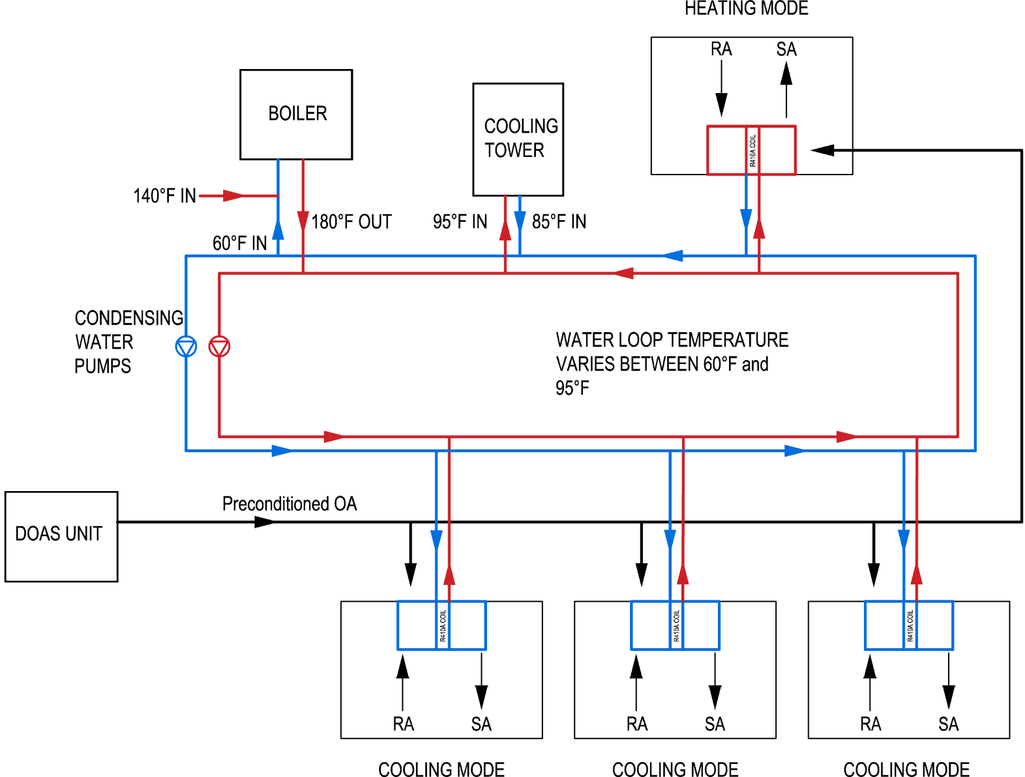
Water Source Heat Pump
Building overview
Thesis Goals
Depth
Dedicated Outdoor Air System
Variable Refrigerant Flow
Water Source Heat Pump
Air Quality Analysis
Energy Comparison
Structural Breadth
Construction Breadth
Conclusion
Water Loop remains between 60°F & 95°F
Uses boiler & cooling tower when it cannot stay in the temperature range
Connects to existing hot water system for 140F minimum flow
All units on same loop, share between offices & patient rooms

Slide 19
Boiler
Building overview
Thesis Goals
Depth
Dedicated Outdoor Air System
Variable Refrigerant Flow
Water Source Heat Pump
Air Quality Analysis
Energy Comparison
Structural Breadth
Construction Breadth
Conclusion
Equipment Tag | Type | Capacity (Btu/h) | Boiler Horse Power (BHP) | Fluid Flow (gpm) | Primary Fuel | NO_{X} Emissions (ppm)
Boiler - 01 | Gas Fired | 511,011 | 20.0 | 621.0 | Natural Gas | 40
Gas Fired Hot Water Boiler
Meets peak heating load during winter operation
Primary fuel is Natural Gas, Secondary fuel is fuel oil
All new equipment will be located in central utility plant

Slide 20
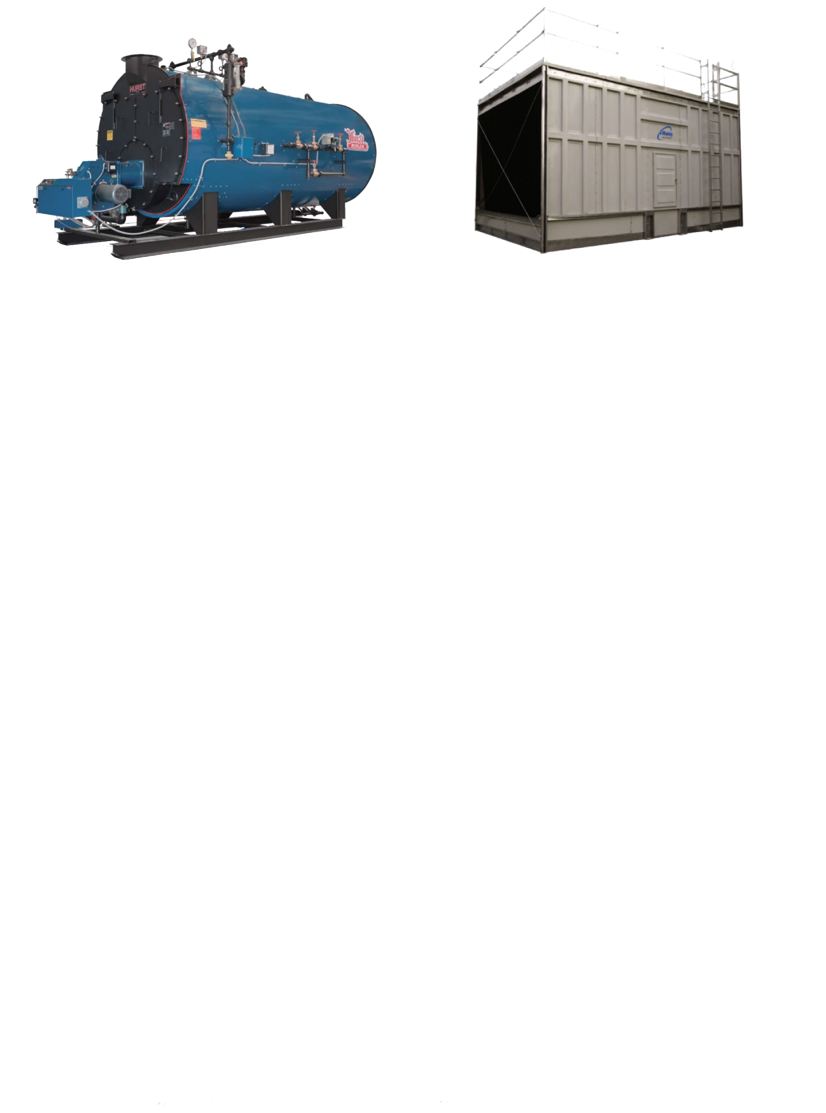
Cooling Tower
Building overview
Thesis Goals
Depth
Dedicated Outdoor Air System
Variable Refrigerant Flow
Water Source Heat Pump
Air Quality Analysis
Energy Comparison
Structural Breadth
Construction Breadth
Conclusion
Equipment Tag | Design Nominal Tonnage | Motor Hp | Fluid Flow (gpm) | Design Ambient WB (°F) | Design EWT (°F) | Design LWT (°F)
Cooling Tower - 01 | 228.0 | 7.5 | 636 | 78 | 95 | 85
Marley Software used for cooling tower
Design for peak cooling load during summer
Design entering water temperature of 95°F WB

Slide 21
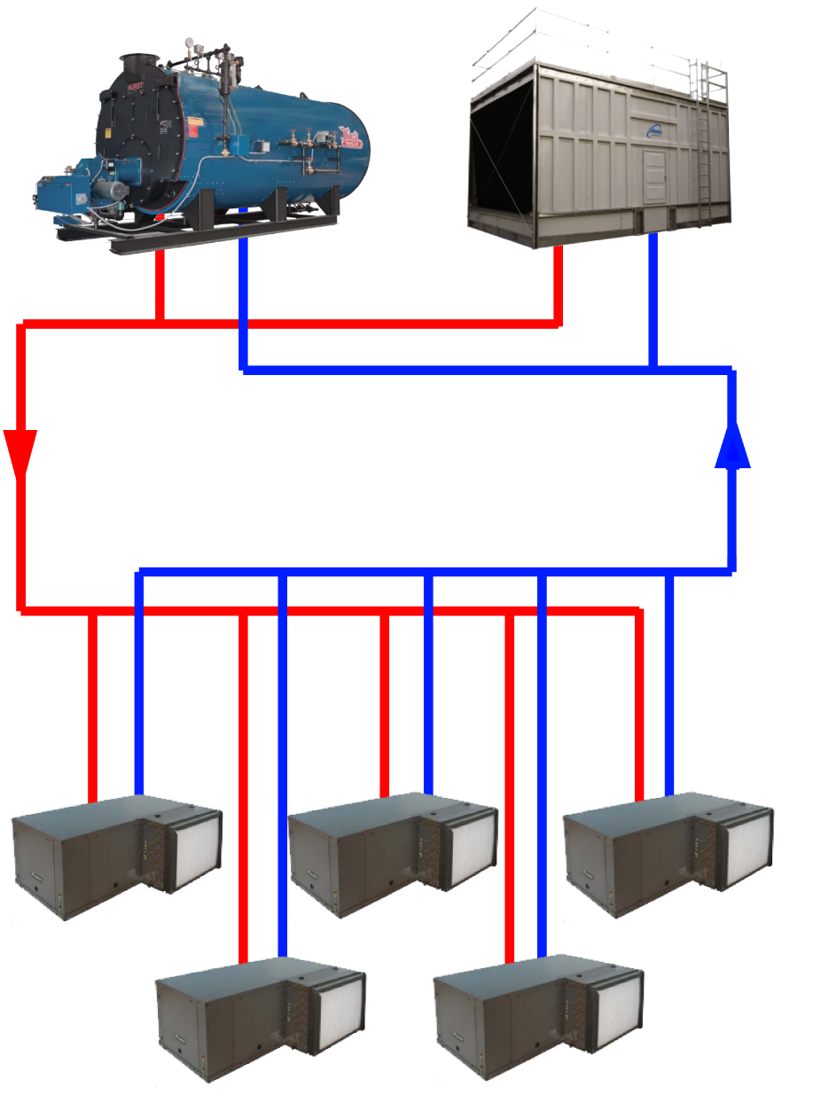
Water Source Heat Pump
Building overview
Thesis Goals
Depth
Dedicated Outdoor Air System
Variable Refrigerant Flow
Water Source Heat Pump
Air Quality Analysis
Energy Comparison
Structural Breadth
Construction Breadth
Conclusion
Room Name | Sensible from AHU (btu/h) | Room Load (btu/h) | Adjusted (btu/h) | Heating (btu/h) | VRF Indoor Unit |  | WSHP Unit
 |  |  |  |  | Cooling | Heating | Cooling | Heating
Medical Bed | 3,169 | 10,528 | 7,359 | 7,270 | 9,600 | 10,900 | 9,700 | 12,000
Medical Bed | 2,868 | 10,528 | 7,659 | 7,270 | 9,600 | 10,900 | 9,700 | 12,000
Medical Bed | 2,868 | 10,528 | 7,659 | 7,270 | 9,600 | 10,900 | 9,700 | 12,000
Medical Bed | 2,868 | 10,528 | 7,659 | 7,270 | 9,600 | 10,900 | 9,700 | 12,000
Medical Bed | 2,868 | 10,528 | 7,659 | 7,270 | 9,600 | 10,900 | 9,700 | 12,000
Medical Bed | 3,169 | 10,528 | 7,359 | 7,270 | 9,600 | 10,900 | 9,700 | 12,000
Pediatric Equipment | 1,036 | 2,649 | 1,613 | 39 | 7,500 | 8,500 | 8,000 | 9,800
Soiled Utility | 216 | 135 | 135 | 0 | 7,500 | 8,500 | 8,000 | 9,800
Nurse Team Center | 1,192 | 2,570 | 1,378 | 40
Remote Monitor Station | 755 | 2,649 | 1,894 | 39
Lab/SAT Poct | 265 | 2,649 | 2,384 | 39

Slide 22
Energy Consumption
WSHP: Electrical Energy Consumption
Building overview
Thesis Goals
Depth
Dedicated Outdoor Air System
Variable Refrigerant Flow
Water Source Heat Pump
Air Quality Analysis
Energy Comparison
Structural Breadth
Construction Breadth
Conclusion
Baseline: Electrical Energy Consumption
Receptacle & fans dominate energy consumed
Space cooling includes both cooling & heating mode
Heat Rejection energy of the Cooling Tower
WSHP saves over 531,242 kWh than baseline

Slide 23
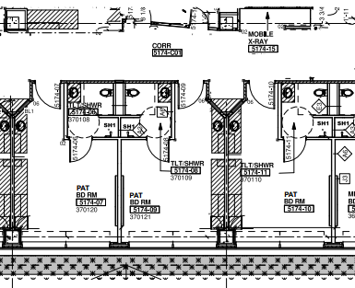
Air Quality Analysis
Building overview
Thesis Goals
Depth
Dedicated Outdoor Air System
Variable Refrigerant Flow
Water Source Heat Pump
Air Quality Analysis
Energy Comparison
Structural Breadth
Construction Breadth
Conclusion
Baseline CO2 Concentration of 652 ppm
Proposed CO2 Concentration of 912 ppm
OSHA OEL of 5,000 ppm

Slide 24
Air Quality Analysis
Building overview
Thesis Goals
Depth
Dedicated Outdoor Air System
Variable Refrigerant Flow
Water Source Heat Pump
Air Quality Analysis
Energy Comparison
Structural Breadth
Construction Breadth
Conclusion
Refrigerant leak based on ASHRAE 15 appendix B: Testing
Leak at rate of 2% by mass of the starting charge per hour
ASHRAE 15 OEL of 1,000 ppm
Passes the oel of R410A within the first hour

Slide 25
Payback Period
Building overview
Thesis Goals
Depth
Dedicated Outdoor Air System
Variable Refrigerant Flow
Water Source Heat Pump
Air Quality Analysis
Energy Comparison
Structural Breadth
Construction Breadth
Conclusion
Initial Cost | VRF | WSHP
Expenses / Savings | Additional Costs | Initial Costs
Cooling Tower | -$29,868 | $0
Boiler - 765 MBH | -$17,800 | $0
Outdoor Condensing Unit | $528,000 | $0
Chiller 270 ton | -$190,500 | -$190,500
Terminal Units | $170,825 | $285,600
Piping | $74,176 | $426,920
DOAS Unit | -$361,000 | -$361,000
Costs | $173,833 | $161,020
Maitnenance Costs
16 Air Cooled Condensers | $138,480 | $0
Cooling Tower | -$8,872 | $0
Chiller - 270 ton | -$104,744 | -$104,744
Boiler - 765 MBH | -$5,835 | $0
Maitnenance Costs | $19,030 | -$104,744
Expenses | $245,596 | $56,276
Annual Energy Costs | $71,763 | $69,108
Simple Payback Period | 3.42 | 0.81
Discounted Payback Period | 8.72 | 2.96
Life Cycle Cost | $2,025,861.00 | $2,631,110.00
Savings | $784,351.66 | $179,102.66
Longer payback period for VRF system than WSHP
Similar initial costs for both
Vary within the maintenance costs of larger equipment
20 year life cycle

Slide 26
Energy & Emissions Comparison
Building overview
Thesis Goals
Depth
Dedicated Outdoor Air System
Variable Refrigerant Flow
Water Source Heat Pump
Air Quality Analysis
Energy Comparison
Structural Breadth
Construction Breadth
Conclusion
Electricity
Consumption
Natural Gas
Consumption
Low Nox Burner For Boilers – 30 ppm, 40 ppm For Proposed
VRF Only uses Natural Gas for DOAS unit
WSHP saves 51% on natural gas, VRF saves 72%

Slide 27
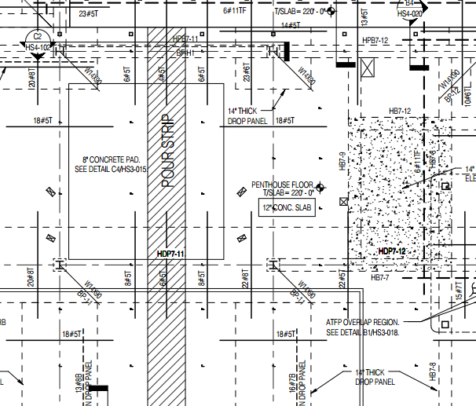
Structural Breadth
Building overview
Thesis Goals
Depth
Dedicated Outdoor Air System
Variable Refrigerant Flow
Water Source Heat Pump
Air Quality Analysis
Energy Comparison
Structural Breadth
Construction Breadth
Conclusion
 | Rebar Size | lb/ft | Number | Weight (lb) | Cost | Total | Savings
Baseline Design | #6 | 1.50 | 24 | 1,219.9 | $1,205 | $7,542 | $4,248
 | #11 | 5.28 | 47 | 8,443.7 | $6,337
Proposed Design | #6 | 1.50 | 44 | 2,236.5 | $2,209 | $3,294
 | #8 | 2.66 | 16 | 1,445.8 | $1,085
Design | Column Strip |  | Middle Strip
 | Neg. Moment | Pos. Moment | Neg. Moment | Pos. Moment
Baseline | 11 (#11) | 18 (#11) | 24 (#6) | 18 (#11)
Reduced Load | 16 (#7) | 18 (#6) | 12 (#6) | 14 (#6)
Equipment | Cooling Capacity (Btu/h) | Number | Operating Weight (lb)
Outdoor Condensing Unit | 72,000 | 11 | 4,972
 | 96,000 | 5 | 2,865
L5 DOAS Unit | 360,000 | 1 | 4,284
L6 DOAS Unit | 300,000 | 1 | 4,282
Cost Savings of $4,248 for reducing load
Original AHUs had 22,000 lb operating weight
Downsized structural system by eliminating anti-force protection & progress collapse resistance loads
Analysis complies with ACI 318 & Direct Design Method

Slide 28
Construction Breadth
Building overview
Thesis Goals
Depth
Dedicated Outdoor Air System
Variable Refrigerant Flow
Water Source Heat Pump
Air Quality Analysis
Energy Comparison
Structural Breadth
Construction Breadth
Conclusion
Removal of IBS Floor
Material | Unit | Amount | Crew | Daily Output | Labor-Hours | Total | Total
 |  |  |  |  |  | Incl. O&P
W6x20 | ft | 4,148 | 8 | 600 | 0.093 | 43 | $178,364
Floor Decking (3" deep, 18 ga) | sq-ft | 39,304 | 5 | 2850 | 0.011 | 4.29 | $168,614
Polypropylene Fiber Rebar Mat | ft³ | 6,550 | 4 | 9500 | 0.004 | 1.07 | $7,009
LW Concrete, 2-1/2" | sq-ft | 39,304 | 8 | 2585 | 0.022 | 3.3 | $129,703
 |  |  |  |  | Total |  | $483,690
 |  |  |  |  | Entire Building |  | $6,046,125
Task | Duration - Man Days
 | Baseline |  | VRF |  | WSHP
 | Man - Days | Total Days | Man - Days | Total Days | Man - Days | Total Days
FR&P Interstitial Floors | 79.96 | 10 | 0.00 | 0 | 0.00 | 0
Install Interstitial Floor Deck | 65.36 | 8 | 0.00 | 0 | 0.00 | 0
Install terminal units | 51.00 | 26 | 76.98 | 38 | 76.98 | 38
Piping | 66.29 | 4 | 16.82 | 17 | 12.83 | 13
Sheetmetal | 32.00 | 11 | 21.33 | 11 | 21.33 | 11
 | Total | 58 | Total | 66 | Total | 62
 | Difference in Duration |  |  | -8 |  | -4
Removing IBS floors gained 18 days
Average installation rate of terminal units in a interstitial floor is 30 minutes quicker
Piping Installation does not take interstitial floor into account

Slide 29
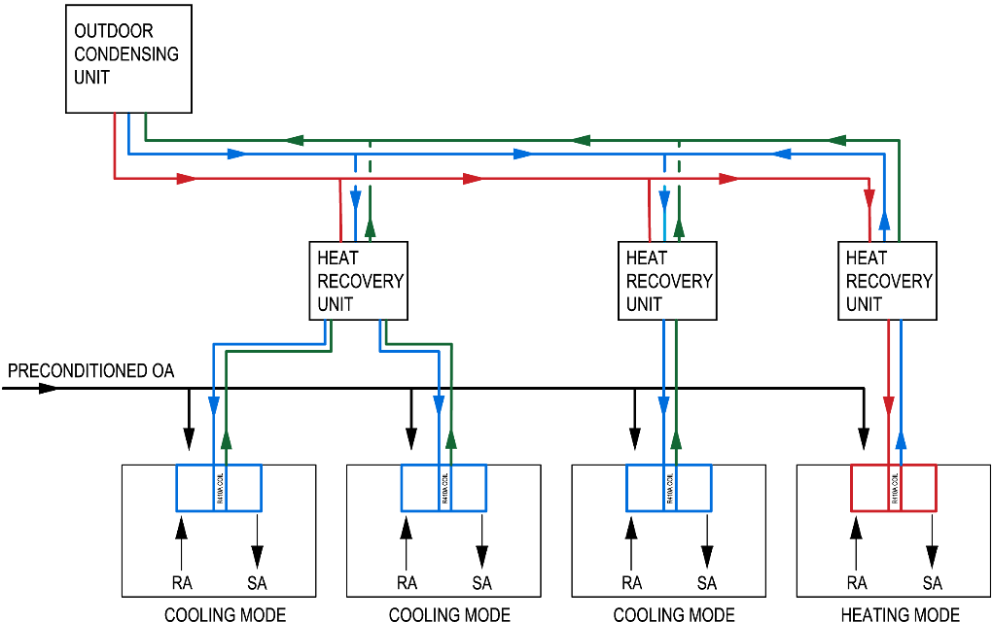
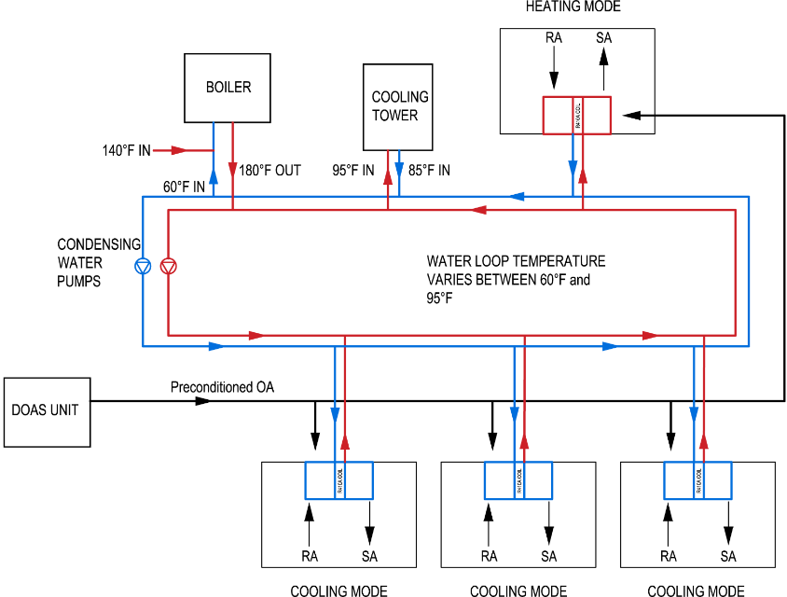
Recommendations
Building overview
Thesis Goals
Depth
Dedicated Outdoor Air System
Variable Refrigerant Flow
Water Source Heat Pump
Air Quality Analysis
Energy Comparison
Structural Breadth
Construction Breadth
Conclusion
Variable Refrigerant Flow
Water Source Heat Pump
Saves 60% in electrical energy consumption
Consumes 72% less natural gas
Payback period of 8.72 years
Takes 16% longer installation time
Saves 31% in electrical energy consumption
Consumes 51% less natural gas
Payback period of 2.96 years
Takes 8% longer installation time

Slide 30
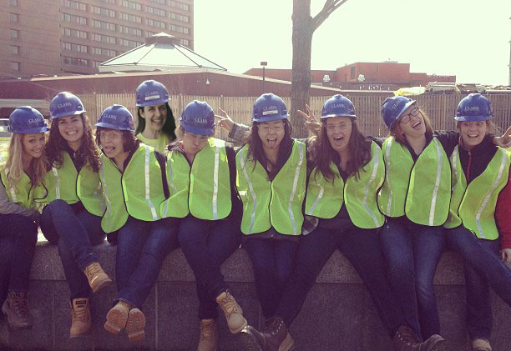
Acknowledgements
Building overview
Thesis Goals
Depth
Dedicated Outdoor Air System
Variable Refrigerant Flow
Water Source Heat Pump
Air Quality Analysis
Energy Comparison
Structural Breadth
Construction Breadth
Conclusion
Michael Morder
Ashley Hayes
Shawn Manley
Dr. W. Bahnfleth
Mechanical Design Engineer, Southland Industries
Project Manager, Southland Industries
Senior Mechanical Engineer, Southland Industries
Thesis Advisor, Professor at Penn State
Penn State Architectural Engineering Faculty
AE Class of 2015
AE Powerplayers
Photos Courtesy of HKS Inc. and Wingler & Sharp Architects, Inc.

Slide 31
Questions?
Carl R. Darnall Army Medical Center Replacement

